Slide 1
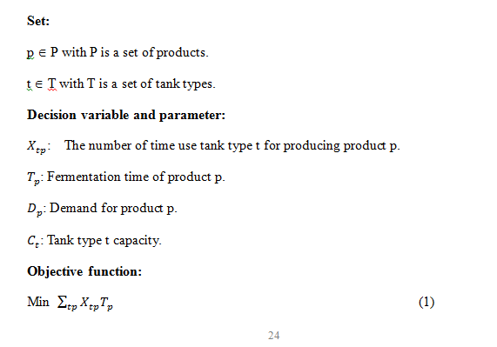
Assign jobs to tank types

Slide 2
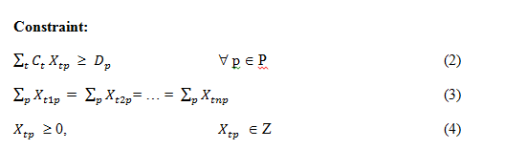
Assign jobs to tank types
The objective function (1) is to minimize the fermentation time of a given quantity demand.
Constraint (2) is to make sure that the demand is always fulfill.
Constraint (3) is to make sure that tank types are use equally.
Equation (4) is the valid condition of decision variables.
Note this in this model, tank types are considered but not specific tanks. Because, the second algorithm will help to choose specific machines in a flexible job shop scheduling problem.

Slide 3
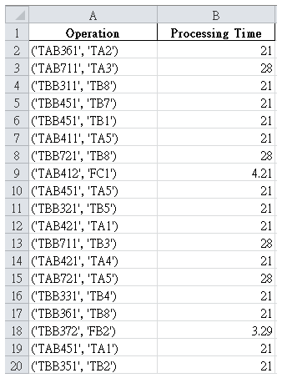
Build the processing time to table
The processing time table is the necessary input data the GA.

Slide 4
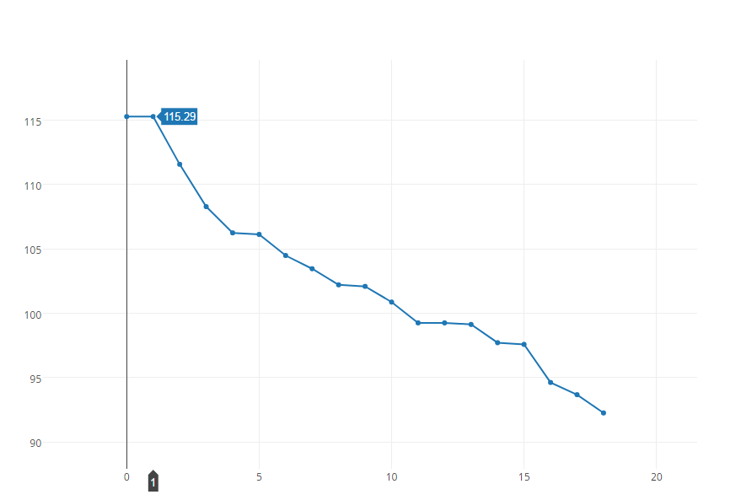
Learning Curve

Slide 5
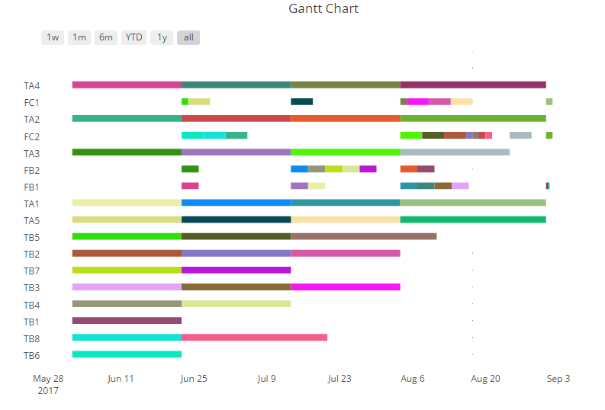
Schedule from the experiment

